Slide 1
UNIT-1
Introduction to computer organization:
Von Neumann architecture
Computer components
Interconnection structures
Bus interconnection

Slide 2
Computer architecture :-Architecture is those attributes visible to the programmer. Example:-instruction set , number of bits used for data representation , i/o mechanism ,etc. Computer organization:-Organization is how features are implemented. Example:-control signals , interfaces , memory technology.
Introduction of computer organization and architecture

Slide 3
Generations of computer
Generation Year Technology Speed(operation per sec.)
1. 1946-1957 Vacuum tube 40,000
2. 1958-1964 Transistor 200,000
3. 1965-1971 Small-and 1,000,000
medium scale
integration
4. 1972-1977 Large-scale 10,000,000
integration
5. 1978-1991 Very-large-scale 100,000,000
integration
6. 1991-till now Ultra-large-scale over 100,000,000
integration

Slide 4
Von Neumann architecture
Stored Program concept
Main memory storing programs and data
ALU operating on binary data
Control unit interpreting instructions from memory and executing
Input and output equipment operated by control unit
Princeton Institute for Advanced Studies
----IAS
Completed 1952

Slide 5
Characteristics of IAS
The memory of he IAS consists of 1000 storage locations called words, of 40 binary digits each.
Both data and instructions are stored there.
Numbers and instruction are represented in binary form.
Each number is represented by a sign bit and a 39 bit value.
A word also contain two 20 bit instruction with 8 bit opcode and 12 bit of address.
The CU fetch instruction from memory and execute them one at a time.

Slide 6
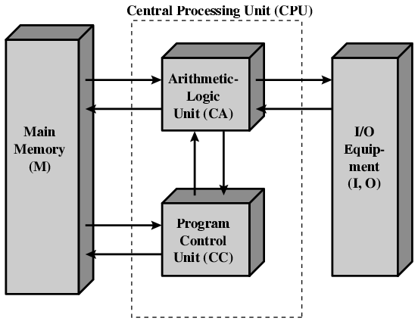
Structure of von Neumann machine

Slide 7
Components
The Control Unit and the Arithmetic and Logic Unit constitute the Central Processing Unit
To feed data and instruction into the system we have input module.
To display result we have output module.
To store data and instruction temporarily we have memory or main memory.

Slide 8
Top level view of computer components
CPU
Memory
.
.
PC
MAR
PC=Program counter
IR=Instruction register
MAR=Memory address
register
MBR=Memory buffer
register
I/O AR=I/O address
register
I/O BR=I/O buffer
register
MBR
Instruction
IR
Instruction
I/O AR
Instruction
.
.
I/O BR
I/O Module
Data
Buffers
Data
Data
.
.
.
.
.

Slide 9
Purpose of registers
MAR- It specifies the address in memory for the next read or write.
MBR- It contains the data to be written in memory or receive from memory.
I/O AR- It specifies a particular I/O device.
I/O BR-It is used for the exchange of data b/w I/O module and CPU.

Slide 10
Interconnection structures
A computer consists of a set of components or module of three basic types(processor , memory , I/O) that communicate with each other.
The collection of paths connecting the various modules is called the interconnection structure.
Memory:-A memory module will consists of N words of equal length . A word of data can be read from or written into the memory. The nature of the operation is indicated by read and write control signals. The operation is specified by an address.
I/O module:-I/O is functionally similar to memory . There are two operations , read and write. It may control more than one external device . I/O module may be able to send interrupt signals to the processor.
Processor:-The processor reads in instruction and data , writes out data after processing , and uses control signals to control the overall operation of the system .It also receives interrupt signals.

Slide 11
Bus Interconnection
A bus is a communication pathway connecting two or more devices .
It is a shared transmission medium.
No two devices can transmit signals at a time , because signal will overlap and become garbled.
Only one device at a time can successfully transmit.
A bus consists of multiple communication pathways or lines .
Each line is capable of transmitting signals representing binary 1 and 0.
A bus that connects major computer components (processor , memory , I/O) is called a system bus.

Slide 12
Bus structure
A system bus consists typically of from 50 to 100 lines.
Each line is assigned a particular meaning or function.
Bus lines can be classified into three functional group:-- data , address, and control lines.

Slide 13
Data bus
The data lines provide a path for moving data between system modules.
These lines are collectively are called the data bus.
It consists of 8,16, 32or 64 bits.
The number of lines are referred to as the width of the data bus.

Slide 14
Address bus
The address lines are used to designate the source or destination of the data on the data bus.
The width of the address bus determines the maximum possible memory capacity of the system.
These are generally used to address I/O ports.

Slide 15
Control bus
The control lines are used to control the access to and the use of the data and address lines.
Control signals transmit both command and timing information between system modules.
Command signals specify operations to be performed.
Typical control lines include the following:-
Memory write
Memory read
I/O write
I/O read
Transfer ACK
Bus request
Bus grant
Interrupt request
Interrupt ACK
Clock
Reset

Slide 16
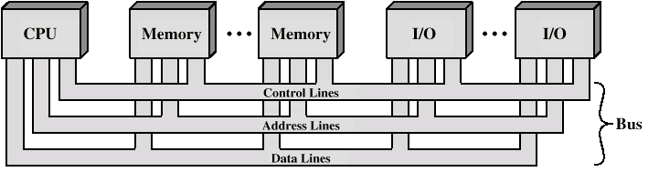
Bus Interconnection Scheme

Slide 17
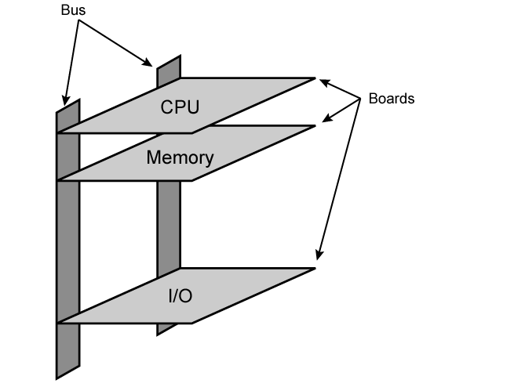
Physical Realization of Bus Architecture

Slide 18
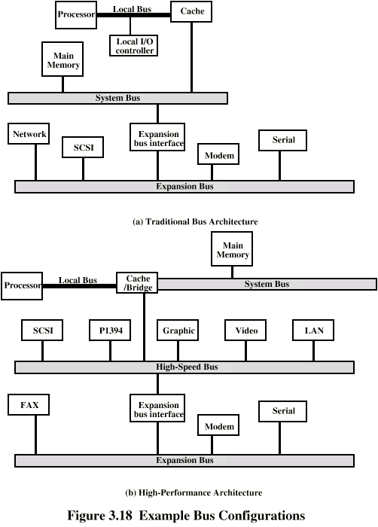
Traditional (ISA) (with cache)

Slide 19
High Performance Bus

Slide 20
Elements of bus design
Type
*Dedicated
*Multiplexed
Method of Arbitration
*Centralized
*Distributed
Timing
*Synchronous
*Asynchronous
Bus width
*Address
*Data
Data transfer type
*Read
*Write
*Read-modify-write
*Read-after-write
*Block

Slide 21
Bus types
Bus lines can be separated into two generic types:-
dedicated and multiplexed.
Dedicated:- A dedicated bus line is permanently assigned either to one function or to a physical subset of computer components.
In functional dedication , the data and address lines are separated.
Physical dedication refers to the use of multiple buses , each of which connects only a subset of modules.
Advantage-less bus contention.
Disadvantage-increased size and cost of the system.
Multiplexed:-The same bus connections are used for the subsequent read or write data transfer.
Advantage-the use of fewer lines , saves space and cost.
Disadvantage-complex circuitry, potential reduction .

Slide 22
Bus arbitration
More than one module may need to control of the bus so arbitration is needed.
Because only one unit at a time can successfully transmit over the bus.
It is classified into centralized and distributed
In centralized scheme a single hardware device referred to as bus controller or arbiter is responsible for allocating time on bus . There is central controller
In distributed scheme each module contains access control logic and the modules set together to share the bus.

Slide 23
Timing
Timing refers to the way in which events are coordinate on the bus .
In Synchronous timing the occurrence of events on the bus is determined by a clock.
A single 1-0 transmission is referred to as a clock cycle or bus cycle.
All other devices on the bus can read the clock line
All events starts at the beginning of the clock cycle .
Most events occupy a single clock cycle.
In asynchronous timing the occurrence of one event on a bus follows and depends on the occurrence of a previous event.

Slide 24
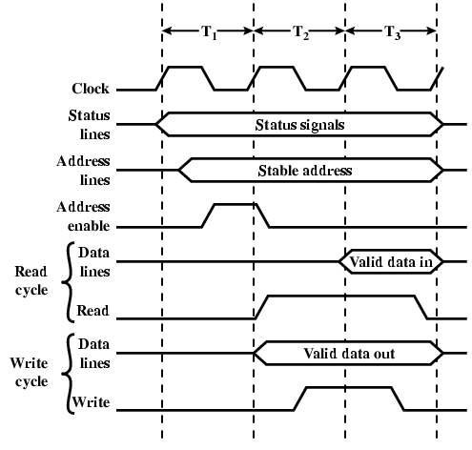
Synchronous Timing Diagram

Slide 25
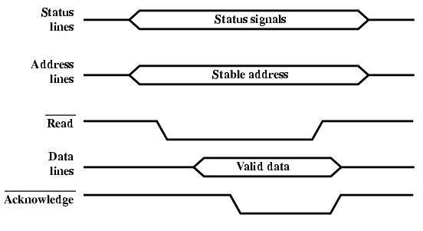
Asynchronous Timing – Read Diagram

Slide 26
PCI Bus
Peripheral Component Interconnection
Intel released to public domain
32 or 64 bit
50 lines

Slide 27
PCI Bus Lines
Systems lines
Including clock and reset
Address & Data
32 time mux lines for address/data
Interrupt & validate lines
Interface Control
Arbitration
Not shared
Direct connection to PCI bus arbiter
Error lines

Slide 28
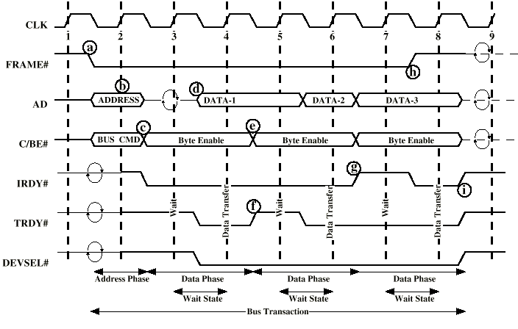
PCI Read Timing Diagram

Slide 29
UNIT -2
Input output organization
DMA
Interrupt driven I/O
Priority interrupt
Asynchronous and synchronous data transfer
Working mechanisms of peripherals

Slide 30
INPUT-OUTPUT ORGANIZATION
The Input / output organization of computer depends upon the size of computer and the peripherals connected to it. The I/O Subsystem of the computer, provides an efficient mode of communication between the central system and the outside environment The most common input output devices are:
i) Monitor
ii) Keyboard
iii) Mouse
iv) Printer
v) Magnetic tapes

Slide 31
Input - Output Interface
Input Output Interface provides a method for transferring information between internal storage and external I/O devices. Peripherals connected to a computer need special communication links for interfacing them with the central processing unit

Slide 32
Interrupt driven I/O
Interrupt driven I/O is an alternative scheme dealing with I/O. Interrupt I/O is a way of controlling input/output activity whereby a peripheral or terminal that needs to make or receive a data transfer sends a signal. This will cause a program interrupt to be set. At a time appropriate to the priority level of the I/O interrupt. Relative to the total interrupt system, the processors enter an interrupt service routine. The function of the routine will depend upon the system of interrupt levels and priorities that is implemented in the processor. The interrupt technique requires more complex hardware and software, but makes far more efficient use of the computer’s time and capacities.
For input, the device interrupts the CPU when new data has arrived and is ready to be retrieved by the system processor. The actual actions to perform depend on whether the device uses I/O ports or memory mapping. For output, the device delivers an interrupt either when it is ready to accept new data or to acknowledge a successful data transfer. Memory-mapped and DMA-capable devices usually generate interrupts to tell the system they are done with the buffer

Slide 33
Advantages & Disadvantages of Interrupt Drive I/O
Advantages
- fast
- efficient
Disadvantages
- can be tricky to write if using a low level language
- can be tough to get various pieces to work well together
-usually done by the hardware manufacturer / OS maker, e.g. Microsoft

Slide 34
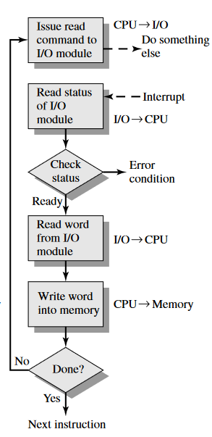
Interrupt-Driven I/O(Diagram)

Slide 35
PRIORITY INTERRUPT
In a typical application, a number of I/O devices are attached to computer, with each device being able to originate an interrupt request, so to provide services to device which initiate interrupt request, the task of interrupt system is to identify the source(device) of interrupt and then provide services to them.
But, in most cases there is a possibility that several sources will request service simultaneously . So, in this case, the interrupt system must also need to decide which device to service first . But, these simple interrupt system are not able for that, so, another system known as Priority interrupt system is provided.
Priority Interrupt are systems, that establishes a Priority over the various sources(interrupt devices) to determine which condition is to be serviced first when two or more requests arrive simultaneously . This system may also determine which condition are permitted to interrupt to the computer while another interrupt is being serviced.
Usually, in Priority Systems, higher-priority interrupt levels are served first, as if they delayed or interrupted, could have serious consequences. And the devices with high-speed transfer such as magnetic disks are given high-priority, and slow devices such as keyboards receives low-priority.

Slide 36
DMA
When large volumes of data are to be moved, a more efficient technique is direct memory access (DMA)
DMA is a method of transferring data from the computer's RAM to another part of the computer without processing it using the CPU. While most data that is input or output from your computer is processed by the CPU, some data does not require processing, or can be processed by another device. In these situations, DMA can save processing time and is a more efficient way to move data from the computer's memory to other devices.

Slide 37
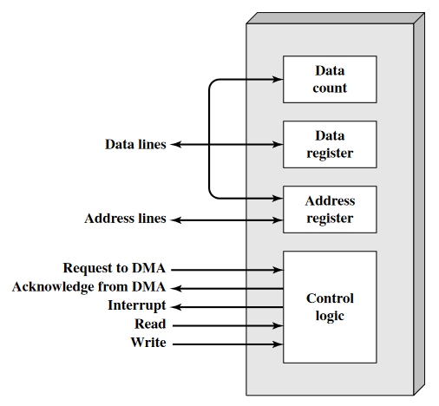
DMA Block Diagram

Slide 38
I/O Processor and serial communication
An input-output processor (IOP) is a processor with direct memory access capability. In this, the computer system is divided into a memory unit and number of processors.
Each IOP controls and manage the input-output tasks. The IOP is similar to CPU except that it handles only the details of I/O processing. The IOP can fetch and execute its own instructions. These IOP instructions are designed to manage I/O transfers only.

Slide 39
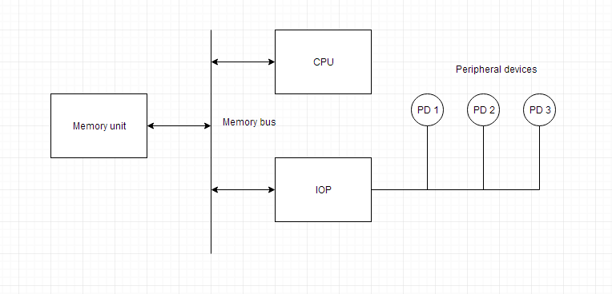
Block Diagram Of I/O Processor

Slide 40
Serial Communication
Serial communication is a communication method that uses one or two transmission lines to send and receive data, and that data is continuously sent and received one bit at a time.Since it allows for connections with few signal wires, one of its merits is its ability to hold down on wiring material and relaying equipment costs.

Slide 41
Synchronous data transfer
In Synchronous Transmission, data is sent in form of blocks or frames. This transmission is the full duplex type. Between sender and receiver the synchronization is compulsory. In Synchronous transmission, There is no gap present between data. It is more efficient and more reliable than asynchronous transmission to transfer the large amount of data.

Slide 42
Asynchronous data transfer
This Scheme is used when speed of I/O devices do not match with microprocessor, and timing characteristics of I/O devices is not predictable. In this method, process initiates the device and check its status. As a result, CPU has to wait till I/O device is ready to transfer
data. When device is ready CPU issues instruction for I/O transfer. In this method two types of techniques are used based on signals before data transfer.
i. Strobe Control
ii. Handshaking

Slide 43
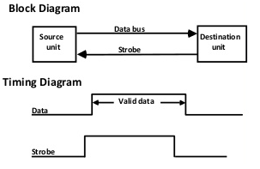
Strobe Control
The strobe control method of Asynchronous data transfer employs a single control line to
time each transfer. The strobe may be activated by either the source or the destination unit.
Data Transfer Initiated by Source Unit:

Slide 44
Handshaking
The handshaking method solves the problem of strobe method by introducing a second
control signal that provides a reply to the unit that initiates the transfer.
Principle of Handshaking:
The basic principle of the two-wire handshaking method of data transfer is as follow:
One control line is in the same direction as the data flows in the bus from the source to destination.
It is used by source unit to inform the destination unit whether there a valid data in the bus.
The other control line is in the other direction from the destination to the source. It is
used by the destination unit to inform the source whether it can accept the data. The
sequence of control during the transfer depends on the unit that initiates the transfer.

Slide 45
Source Initiated Transfer using Handshaking
The sequence of events shows four possible states that the system can be at any given time.
The source unit initiates the transfer by placing the data on the bus and enabling its data valid
signal. The data accepted signal is activated by the destination unit after it accepts the data
from the bus. The source unit then disables its data accepted signal and the system goes into
its initial state.

Slide 46
WORKING MECHANISM OF PERIPHERALS
Working Principle of a Keyboard:-
Inside the keyboard, there are metallic plate, circuit board and processor, which are responsible for transferring information from the keyboard to the computer. Depending upon the working principle, there are two main types of keys, namely, capacitive and hard-contact.
Let's discuss in brief about the functioning of capacitive and hard contact key . When a capacitive key is pressed, the metal plunger applies a gentle pressure to the circuit board. The pressure is identified by the computer and the circuit flow is initiated, resulting in the transfer of information from the circuit to the currently installed software.
The key identifying to computer is identified using a keyboard driver and finding the preferred key calledsource code.

Slide 47
WORKING MECHANISM OF MOUSE
With most of the system you will find mechanical mouse . The primary mechanical part of a mouse is a ball on the bottom of the mouse. There are these little wheels which turn/rotate when the ball moves against them. The wheels are monitored electronically. When they turn or rotate they transmit how much they have turned to the computer. Out of these three wheels the two wheels perpendicular to each other are used for tracking the motion on X-axis and Y-axis. The third one just balances the two.
When the mouse is moved on a flat surface the roller ball moves in the locking ring. When the mouse is positioned on the desktop the actuators register the mouse balls movement in X-axis and Y-axis direction. The sensors attached to it generate a series of pulses representing movement on both axis.

Slide 48
WORKING OF SCANNER
A scanner is a device that is used for producing an exact digital image replica of a photo, text written in paper, or even an object. This digital image can be saved as a file to your computer and can be used to alter/enhance the image or apply it to the web. The most commonly used scanner is the flatbed scanner, in which you keep the object on top of the glass window. The scanned output will be obtained in your computer. The image and text are obtained exactly through the process of optical character recognition [OCR].
Handheld scanners use the same basic technology as a flatbed scanner, but rely on the user to move them instead of a motorized belt. This type of scanner typically does not provide good image quality. However, it can be useful for quickly capturing text.
• Drum scanners are used by the publishing industry to capture incredibly detailed images. They use a technology called a photomultiplier tube (PMT). In PMT, the document to be scanned is mounted on a glass cylinder. At the centre of the cylinder is a sensor that splits light bounced from the document into three beams.
Each beam is sent through a colour filter into a photomultiplier tube where the light is changed into an electrical signal.
• The basic principle of a scanner is to analyze an image and process it in some way. Image and text capture (optical character recognition or OCR) allow you to save information to a file on your computer.

Slide 49
WORKING OF VIDEO DISPLAY
Video display device means an electronic device with an output surface that displays, or is capable of displaying, moving graphical images or a visual representation of image sequences or pictures, showing a number of quickly changing images on a screen in fast succession to create the illusion of motion, including, if applicable, a device that is an integral part of the display, in that it cannot be easily removed from the display by the consumer, that produces the moving image on the screen.
A video display device may use, but is not limited to, a cathode ray tube (CRT), liquid crystal display (LCD), gas plasma, digital light processing, or other image projection technology. device means a printer or a unit capable of presenting images electronically on a screen, with a video display greater than four inches when measured diagonally, that are viewed by the user, and include televisions, computer monitors, laptop computers, cathode ray tubes, plasma displays, liquid crystal displays, rear and front enclosed projection devices, and other similar displays that may be developed.

Slide 50
Unit-3
Memory organization:
Memory hierarchy
Types of memory
Cache memory
Virtual memory
RAM and ROM with types

Slide 51
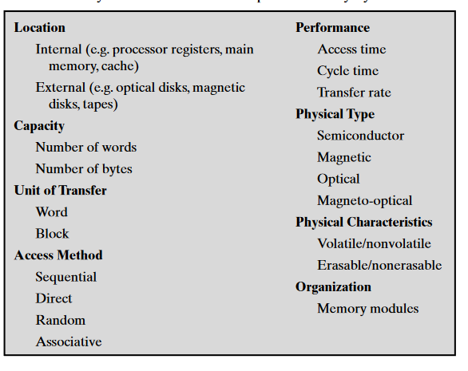
Computer Memory Systems
Computer memory is organized into a hierarchy.

Slide 52
MEMORY HIERARCHY
The memory in a computer can be divided into five hierarchies based on the speed as well as use. The processor can move from one level to another based on its requirements:-
PRIMARY MEMORY:-
It is also called as internal memory. It includes main memory, cache & registers.
SECONDARY MEMORY:-
It is also called external memory and this is accessible by the processor through an input/output module. This memory includes an optical disk, magnetic disk, and magnetic tape

Slide 53
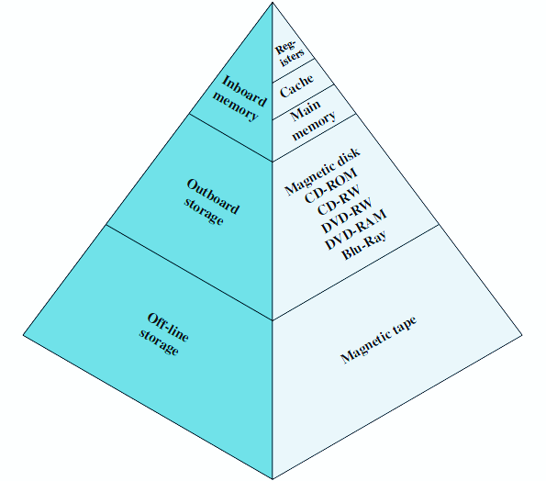
The Memory Hierarchy
Three key characteristics of memory namely: capacity, access time, and cost.
Relationships:
Faster access time, greater cost per bit
Greater capacity, smaller cost per bit
Greater capacity, slower access time

Slide 54
Characteristics of memory hierarchy
PERFORMANCE:-
Previously, the designing of a computer system was done without memory hierarchy, and the speed gap among the main memory as well as the CPU registers enhances because of the huge disparity in access time, which will cause the lower performance of the system. So, the enhancement was mandatory. The enhancement of this was designed in the memory hierarchy model due to the system’s performance increase.
Ability:-
The ability of the memory hierarchy is the total amount of data the memory can store. Because whenever we shift from top to bottom inside the memory hierarchy, then the capacity will increase.

Slide 55
ACCESS TIME:-
The access time in the memory hierarchy is the interval of the time among the data availability as well as request to read or write. Because whenever we shift from top to bottom inside the memory hierarchy, then the access time will increase
COST PER BIT:-
When we shift from bottom to top inside the memory hierarchy, then the cost for each bit will increase which means an internal Memory is expensive compared with external memory.

Slide 56
CACHE MEMORY:-Cache memory can also be found in the processor, however rarely it may be another IC (integrated circuit) which is separated into levels. The cache holds the chunk of data which are frequently used from main memory.
MAIN MEMORY:-The main memory in the computer is nothing but, the memory unit in the CPU that communicates directly. It is the main storage unit of the computer. This memory is fast as well as large memory used for storing the data throughout the operations of the computer. This memory is made up of RAM as well as ROM.

Slide 57
MAGNETIC DISKS:-The magnetic disks in the computer are circular plates fabricated of plastic otherwise metal by magnetized material. All the disks in computer turn jointly at high speed. The tracks in the computer are nothing but bits which are stored within the magnetized plane in spots next to concentric circles. These are usually separated into sections which are named as sectors.
MAGNETIC TAPE:-This tape is a normal magnetic recording which is designed with a slender magnetizable covering on an extended, plastic film of the thin strip. This is mainly used to back up huge data. The access time of memory will be slower within magnetic strip as well as it will take a few minutes for accessing a strip.

Slide 58
Advantages of Memory Hierarchy
The need for a memory hierarchy includes the following.
Memory distributing is simple and economical.
Removes external destruction.
Data can be spread all over.
Permits demand paging & pre-paging.
Swapping will be more proficient.

Slide 59
Internal Memory
In computer, all of the storage spaces that are accessible by a processor without the use of computer input/output channels.
Internal Memory usually includes several types of storage such as main storage, cache storage, cache memory and special registers, all of which can be directly accessed by the processor.
It typically refers to the main memory(RAM) but may also refer to ROM and Flash Memory. In either case, internal memory generally refers to chips rather than disks or tapes.
It often refers to simply as memory, is the only one directly accessible to the CPU.

Slide 60
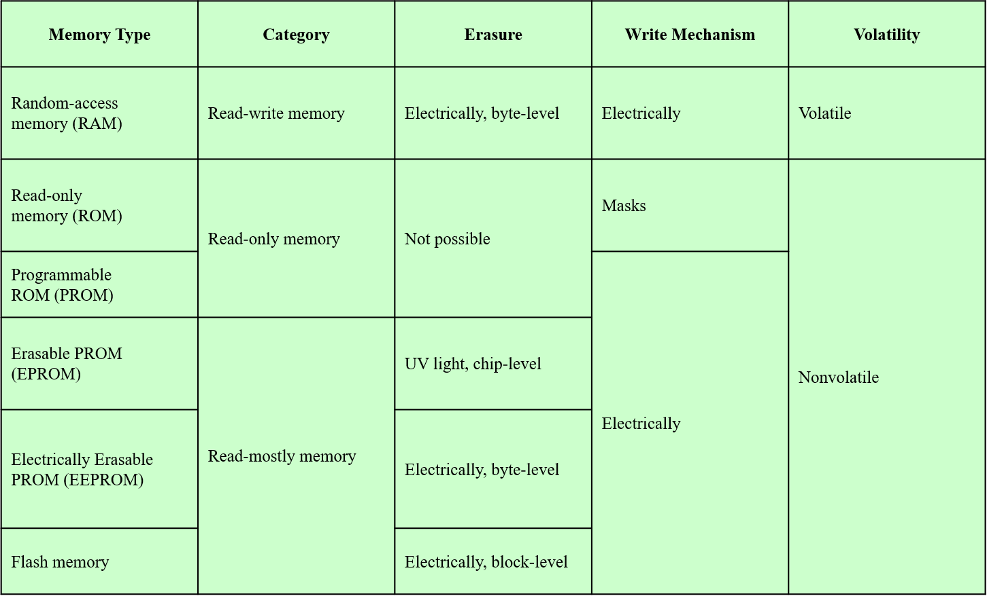
Secondary memory types

Slide 61
RAM(RANDOM ACCESS MEMORY)
Misnamed as all semiconductor memory is random access
Read/Write
Volatile
Temporary storage
Static or dynamic

Slide 62
Dynamic RAM
Bits stored as charge in capacitors
Charges leak.
Need refreshing even when powered
Simpler construction
Smaller per bit
Less expensive
Need refresh circuits
Slower
Main memory
Essentially analogue
Level of charge determines value

Slide 63
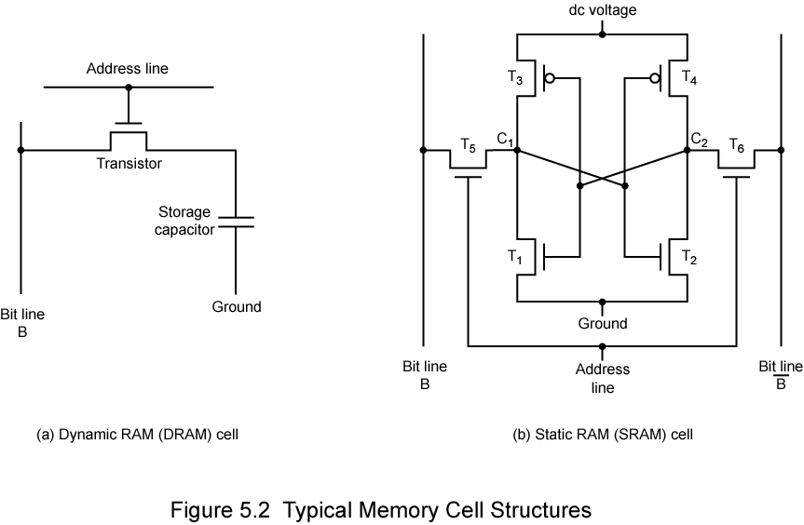
Structure of Dynamic RAM

Slide 64
STATIC RAM
Bits stored as on/off switches
No charges to leak
No refreshing needed when powered
More complex construction
Larger per bit
More expensive
Does not need refresh circuits
Faster
Cache
Digital
Uses flip-flops

Slide 65
Structure of Static RAM

Slide 66
Synchronous DRAM(SDRAM)
Access is synchronized with an external clock.
Address is presented to RAM.
RAM finds data (CPU waits in conventional DRAM)
Since SDRAM moves data in time with system clock, CPU knows when data will be ready
CPU does not have to wait, it can do something else
Burst mode allows SDRAM to set up stream of data and fire it out in block
DDR-SDRAM sends data twice per clock cycle (leading & trailing edge)

Slide 67
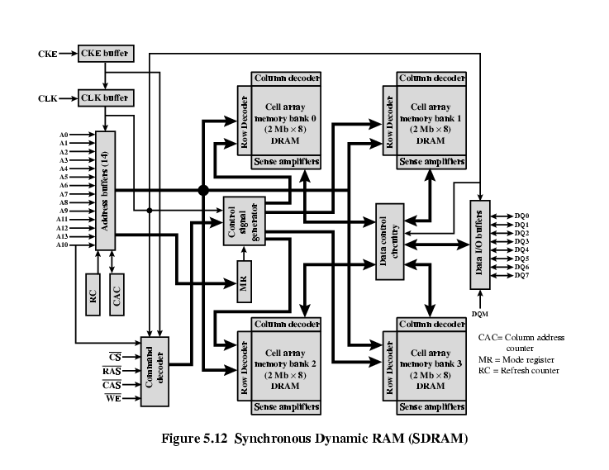
Structure of SDRAM

Slide 68
ROM(READ ONLY MEMORY)
Permanent storage.
Nonvolatile.
Retain data even without electricity flow i.e. power off.
Pre-written(holds code for booting-up the computer).
Systems programs (BIOS).
Data in unchangeable in this.

Slide 69
Types of ROM
ROM.
PROM.
EPROM.
EEPROM.
Flash memory.

Slide 70
PROM : Short for programmable read-only memory, a memory chip on which data can be written only once. Once a program has been written onto a PROM, it remains there forever. Unlike RAM, PROMs retain their contents when the computer is turned off. The difference between a PROM and a ROM (read-only memory) is that a PROM is manufactured as blank memory, whereas a ROM is programmed during the manufacturing process. To write data onto a PROM chip, you need a special device called a PROM programmer or PROM burner. The process of programming a PROM is sometimes called burning the PROM.
EPROM : Acronym for erasable programmable read-only memory, and pronounced eeprom , EPROM is a special type of memory that retains its contents until it is exposed to ultraviolet light. The ultraviolet light clears its contents, making it possible to reprogram the memory. To write to and erase an EPROM, you need a special device called a PROM programmer or PROM burner.

Slide 71
EEPROM : Short form of electrically erasable programmable read-only memory. EEPROM is a special type of PROM that can be erased by exposing it to an electrical charge. Like other types of PROM, EEPROM retains its contents even when the power is turned off. Also like other types of ROM, EEPROM is not as fast as RAM.

Slide 72
External Memory
An external storage device, also referred to as auxiliary storage and secondary storage, is a device that contains all the addressable data storage that is not inside a computer's main storage or memory. An external storage device can be removable or non-removable, temporary or permanent, and accessible over a wired or wireless network.
Types:
Magnetic Disk
RAID
Removable
Optical
CD-ROM
CD-Recordable (CD-R)
CD-R/W
DVD
Magnetic Tape

Slide 73
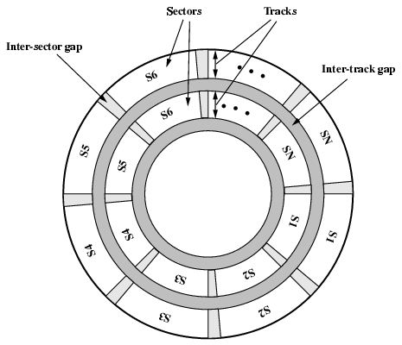
MAGNETIC DISK
A magnetic disk is a storage device that uses a magnetization process to write, rewrite and access data. It is covered with a magnetic coating and stores data in the form of tracks, spots and sectors. Hard disks, zip disks and floppy disks are common examples of magnetic disks.
-The Disk substrate coated with magnetizable material (iron oxide…rust).
-Before, the Substrate used to be aluminium but now its glass.
-The surface uniformity is improved which increases reliability.
-Reduction in surface defects(Reduced read/write errors).
-Lower flight heights

Slide 74
RAID
Redundant Array of Independent Disks
Redundant Array of Inexpensive Disks
6 levels in common use
Not a hierarchy
Set of physical disks viewed as single logical drive by O/S
Data distributed across physical drives
Can use redundant capacity to store parity information

Slide 75
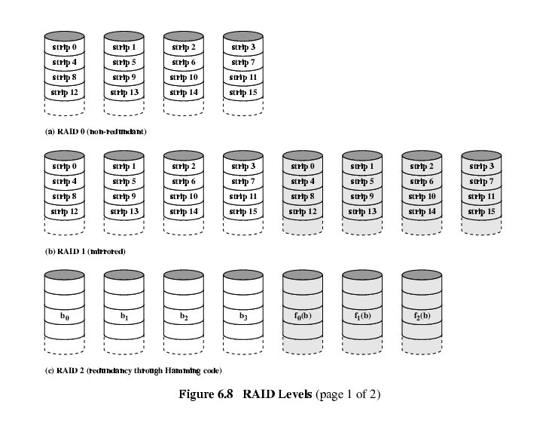
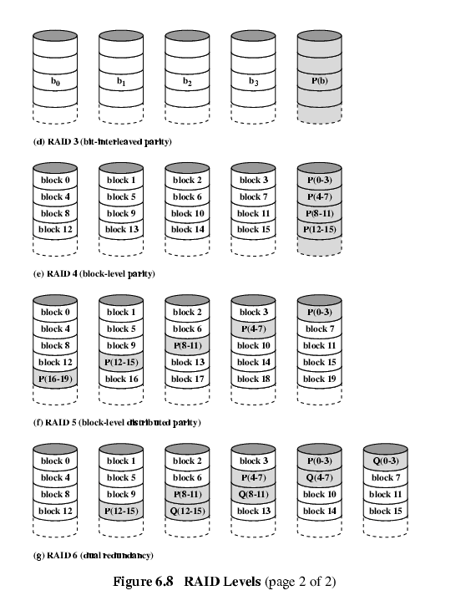
RAID 3 & 4
RAID 1 & 2
RAID 5 & 6

Slide 76
Optical CD-ROM
It is originally for audio
650Mbytes giving over 70 minutes audio
It is Polycarbonate coated with highly reflective coat, usually aluminium.
Data stored as pits.
Read by reflecting laser.
Constant packing density.
Constant linear velocity.

Slide 77
CD-Recordable (CD-R)
WORM.
Now affordable.
Compatible with CD-ROM drives.
CD-RW
Erasable.
Getting cheaper.
Mostly CD-ROM drive is compatible.
Phase change.
Material has two different reflectivities in different phase states.

Slide 78
DVD
A DVD is a type of optical media used for storing digital data. It is the same size as a CD, but has a larger storage capacity. Some DVDs are formatted specifically for video playback, while others may contain different types of data, such as software programs and computer files.
Digital Video Disk
Used to indicate a player for movies
Only plays video disks
Digital Versatile Disk
Used to indicate a computer drive

Slide 79
PROPERTIES OF DVD
It is Multi-layer
Very high capacity (4.7G per layer)
Full length movie on single disk.
Using MPEG compression.
Finally standardized.
Movies carry regional coding.
Players only play correct region films.
Can be “fixed”.

Slide 80
Cache Memory
It is very special high speed memory. It is used to speed up and synchronizing with high speed CPU.
Cache memory is costlier than main memory or disk memory but economical than CPU registers.
Cache memory is an extremely fast memory type that acts as a buffer between RAM and the CPU.
It holds frequently requested data and instruction so that they are immediately available to the CPU when needed.

Slide 81
Characteristics of cache memory
LOCATION:-
CPU
Internal
External
CAPACITY:-
Word size
The natural unit of organisation.
Number of words(or bytes).
UNIT OF TRANSFER:-
Internal
Usually governed by data bus width
External
Usually a block which is much larger than a word
Addressable unit
Smallest location which can be uniquely addressed
ACCESS METHOD:-
Sequential
eg:-Tape
Direct
eg:-Disk
Random
eg:-RAM
Associative
eg:-CACHE

Slide 82
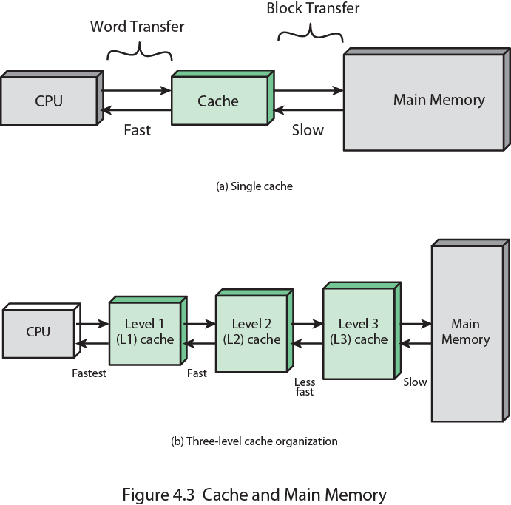
Cache and Memory

Slide 83
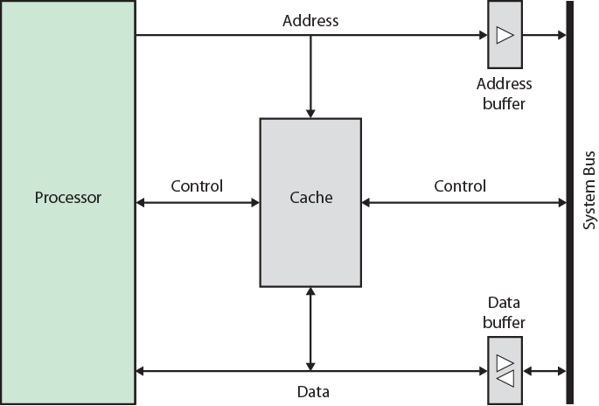
Cache organization

Slide 84
Unit- 4
CPU organization:
General register , stack , accumulator .
Instruction formats-three , two , one and zero address.
Instruction set
Addressing modes

Slide 85
ADDRESSING
The address field or fields in a typical instruction format are relatively small.
We would like to be able to reference a large range of locations in main memory or, for some systems, virtual memory.
To achieve this objective, a variety of addressing techniques has been employed.
They all involve some trade-off between address range and/or addressing flexibility, on the one hand, and the number of memory references in the instruction and/or the complexity of address calculation, on the other .
In this section, we examine the most common addressing techniques:
•Immediate
•Direct
•Indirect
•Register
• Register indirect
•Displacement
•Stack

Slide 86
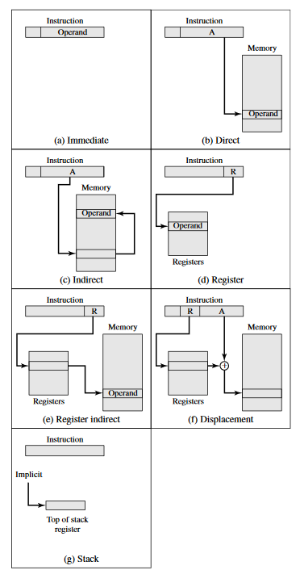
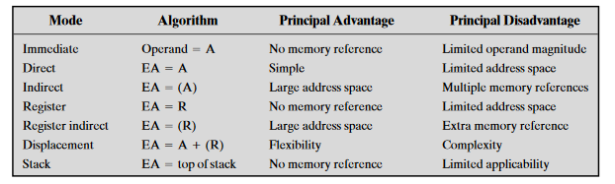
Addressing Modes
(X)=contents of memory location X or register X EA=actual(effective) address of the location containing the referenced operand
R=contents of an address field in the instruction that refers to a register
A=contents of an address field in the instruction
Basic addressing modes

Slide 87
Immediate Addressing
The simplest form of addressing is immediate addressing, in which the operand value is present in the instruction
Operand=A
This mode can be used to define and use constants or set initial values of variables. Typically, the number will be stored in twos complement form; the left-most bit of the operand field is used as a sign bit. When the operand is loaded into a data register, the sign bit is extended to the left to the full data word size . In some cases, the immediate binary value is interpreted as an unsigned non negative integer .
The advantage of immediate addressing is that no memory reference other than the instruction fetch is required to obtain the operand, thus saving one memory or cache cycle in the instruction cycle. The disadvantage is that the size of the number is restricted to the size of the address field, which, in most instruction sets, is small compared with the word length.

Slide 88
Direct Addressing
A very simple form of addressing is direct addressing, in which the address field contains the effective address of the operand :
EA=A
The technique was common in earlier generations of computers but is not common on contemporary architectures. It requires only one memory reference and no special calculation. The obvious limitation is that it provides only a limited address space.

Slide 89
Indirect Addressing
With direct addressing, the length of the address field is usually less than the word length, thus limiting the address range. One solution is to have the address field refer to the address of a word in memory, which in turn contains a full-length address of the operand. This is known as indirect addressing:
EA=(A)
As defined earlier, the parentheses are to be interpreted as meaning contents of . The obvious advantage of this approach is that for a word length of N , an address space of 2^n is now available. The disadvantage is that instruction execution requires two memory references to fetch the operand: one to get its address and a second to get its value.

Slide 90
Register Addressing
Register addressing is similar to direct addressing. The only difference is that the address field refers to a register rather than a main memory address:
EA=R
Register Indirect Addressing
Just as register addressing is an analogous to direct addressing, register indirect addressing is analogous to indirect addressing. In both cases, the only difference is whether the address field refers to a memory location or a register. Thus, for register indirect address ,
EA=(R)
The advantages and limitations of register indirect addressing are basically the same as for indirect addressing. In both cases, the address space limitation (limited range of addresses) of the address field is overcome by having that field refer to a word-length location containing an address. In addition, register indirect addressing uses one less memory reference than indirect addressing.

Slide 91
Displacement Addressing
A very powerful mode of addressing combines the capabilities of direct addressing and register indirect addressing. It is known by a variety of names depending on the context of its use, but the basic mechanism is the same. We will refer to this as displacement addressing:
EA=A+(R)
Displacement addressing requires that the instruction have two address fields, at least one of which is explicit. The value contained in one address field (value=A)
is used directly. The other address field, or an implicit reference based on opcode , refers to a register whose contents are added to A to produce the effective address . We will describe three of the most common uses of displacement addressing:
•Relative addressing
•Base-register addressing
• Indexing

Slide 92
Number of Addresses
One of the traditional ways of describing processor architecture is in terms of the number of addresses contained in each instruction. This dimension has become less significant with the increasing complexity of processor design.
we would need a maximum of two ad-dresses to reference source operands. The result of an operation must be stored , suggesting a third address, which defines a destination operand. Finally, after completion of an instruction, the next instruction must be fetched, and its address is needed

Slide 93
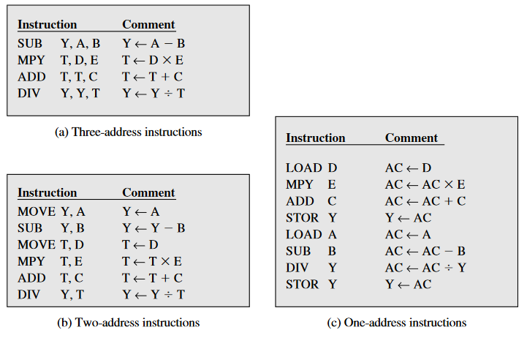
Below figure compares typical one-, two-, and three-address instructions that could be used to compute
Y=(A-B)/[C+(D*E)].With three addresses , each instruction specifies two source operand locations and a destination operand location. Because we choose not to alter the value of any of the operand locations, a temporary location, T, is used to store some intermediate results. Note that there are four instructions and that the original expression had five operands . Three-address instruction formats are not common because they require a relatively long instruction format to hold the three address references.

Slide 94
Three address
Three-address instruction formats are not common because they require a relatively long instruction format to hold the three address references. With two-address instructions, and for binary operations, one address must do double duty as both an operand and a result. Thus, the instruction SUB Y, B carries out the calculation Y-B and stores the result in Y.

Slide 95
Two address
The two-address format reduces the space requirement but also introduces some awkwardness. To avoid altering the value of an operand, a MOVE instruction is used to move one of the values to a result or temporary location before performing the operation. Our sample program expands to six instructions.

Slide 96
One address and Accumulator
The one-address instruction , for this to work, a second address must be implicit. This was common in earlier machines, with the implied address being a processor register known as the accumulator(AC). The accumulator contains one of the operands and is used to store the result. In our example, eight instructions are needed to accomplish the task.

Slide 97
Zero address and Stack
Zero-address instructions are applicable to a special memory organization, called a stack . A stack is a last-in-first-out set of locations. The stack is in a known location and, often, at least the top two elements are in processor registers. Thus, zero-address instructions would reference the top two stack elements.

Slide 98
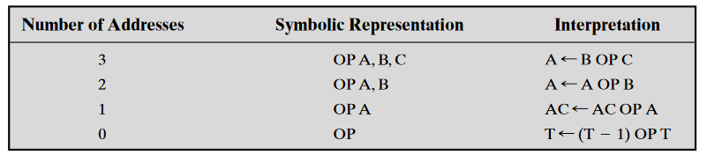
Utilization of Instruction Addresses
AC=accumulator
T =top of stack
(T-1)=second element of stack
A,B,C=memory or register locations

Slide 99
Instruction set
The instruction set is the programmer’s means of controlling the processor. Thus, programmer requirements must be considered in designing the instruction set.
The most important of these fundamental design issues include the following:
•Operation repertoire : How many and which operations to provide, and how complex operations should be
•Data types : The various types of data upon which operations are performed
•Instruction format : Instruction length (in bits), number of addresses, size of various fields, and so on
•Registers : Number of processor registers that can be referenced by instructions , and their use
•Addressing : The mode or modes by which the address of an operand is specified

Slide 100
Unit- 5
Control Unit:
Fetch cycle
Execution cycle
Microprogramming concepts

Slide 101
MICROPROGRAMMING
Microprogramming, Process of writing microcode for a microprocessor. Microcode is low-level code that defines how a microprocessor should function when it executes machine-language instructions. Typically, one machine-language instruction translates into several microcode instructions. On some computers, the microcode is stored in ROM and cannot be modified; on some larger computers, it is stored in EPROM and therefore can be replaced with newer versions

Slide 102
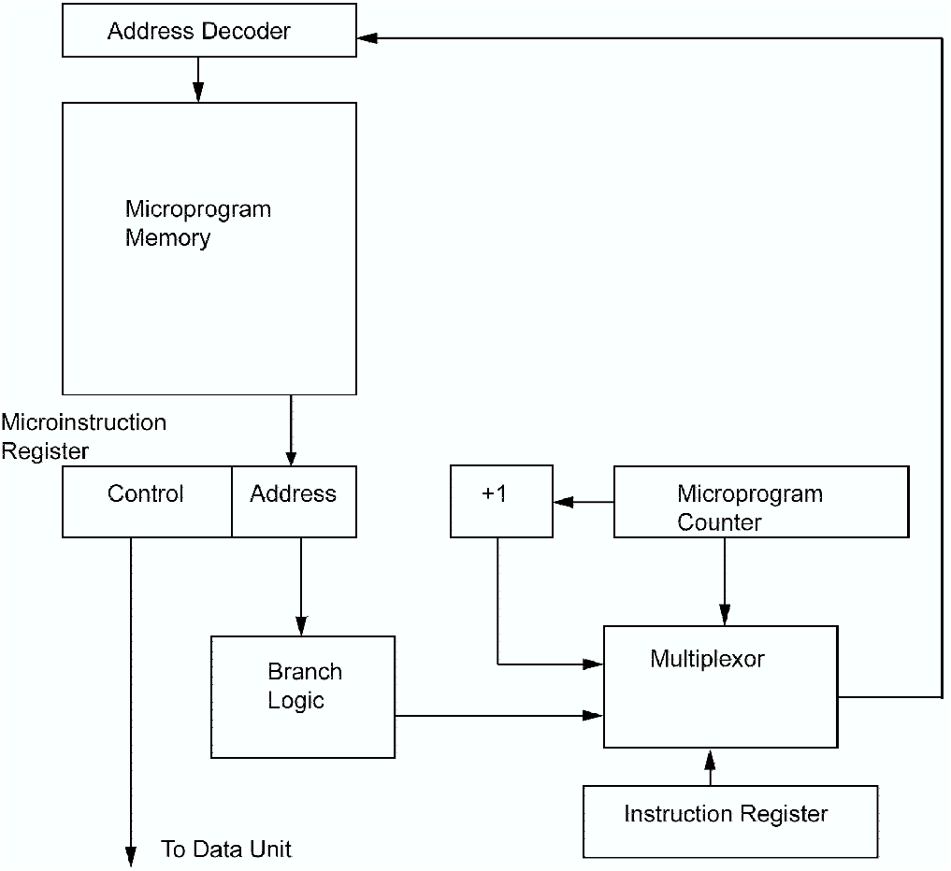
MICROPROGRAMMING

Slide 103
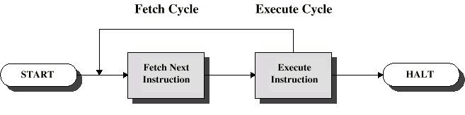
Instruction cycle
There are two steps in it:
Fetch cycle
Execute cycle

Slide 104
Fetch cycle
At the beginning of each instruction cycle, processor fetches the instruction from memory
Program counter(PC) holds the address of next instruction .
The processor always increment the PC after each instruction ,so that next instruction fetched in sequence.
The fetched instruction is loaded into a register in the processor known as the instruction register(IR).
The processor interprets the instruction and performs the required action.

Slide 105
Execute cycle
Processor memory :- Data may be transferred from processor to memory or vice versa.
Processor-I/O :- Data may be transferred to or from a peripheral device by transferring between the and an I/O module.
Data processing:- The processor may perform some arithmetic or logic operation on data.
Control :- An instruction may specify that the sequence of execution be altered.
An instruction’s execution my involve a combination of these actions.

Slide 106
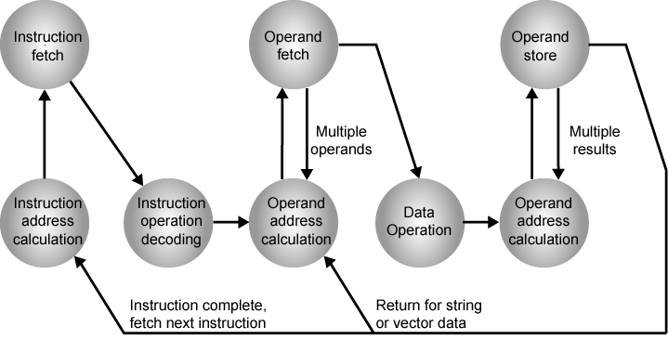
Instruction Cycle State Diagram

Slide 107
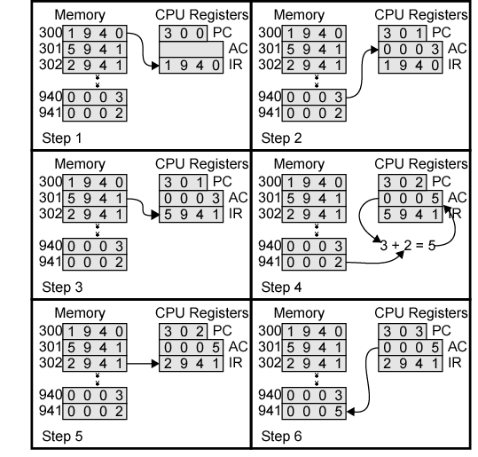
Example of Program Execution

